Slide 1

Danny Mancheno’s Presentation

Slide 2
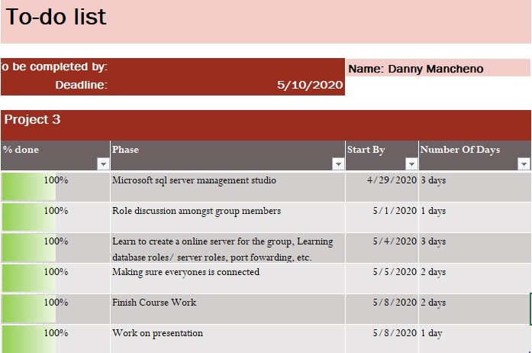
To do list

Slide 3
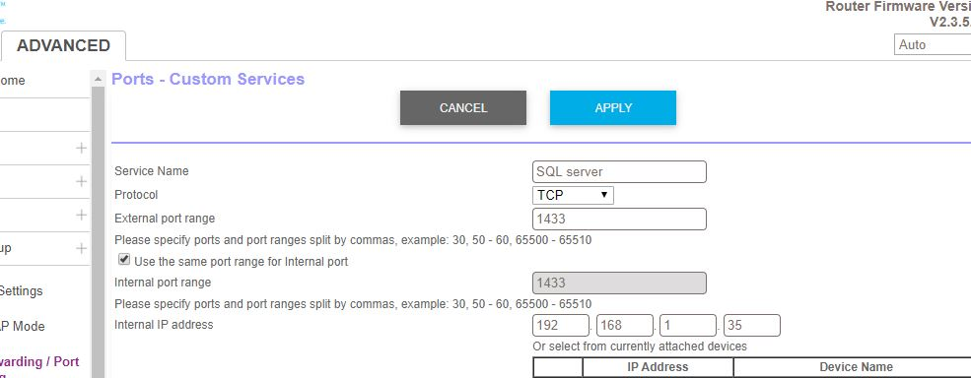
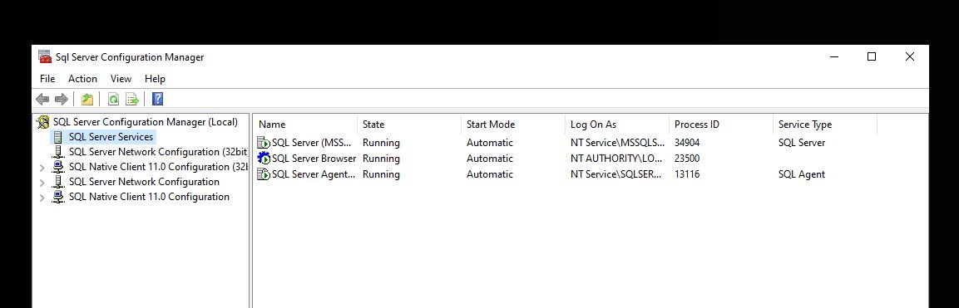
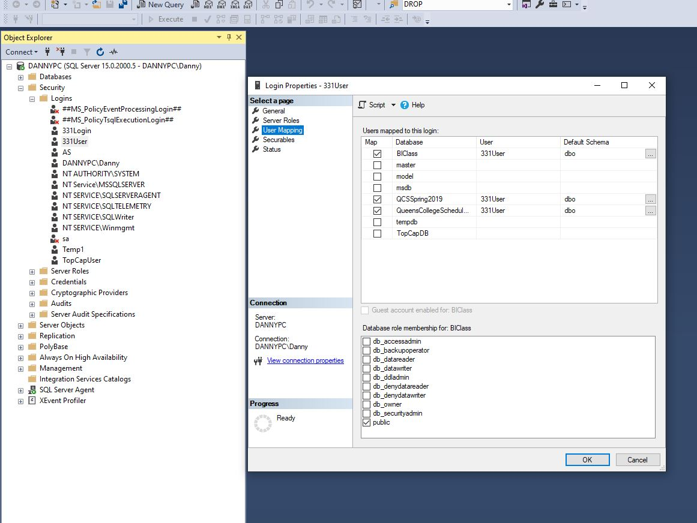
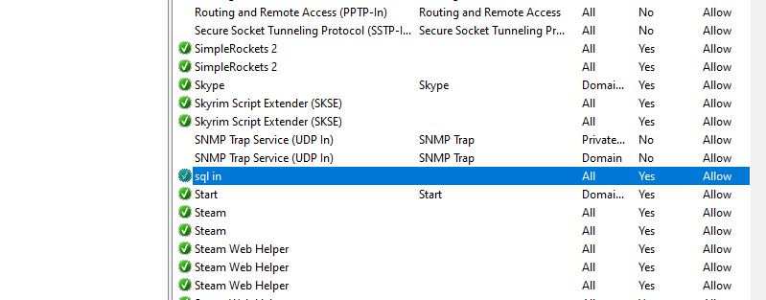
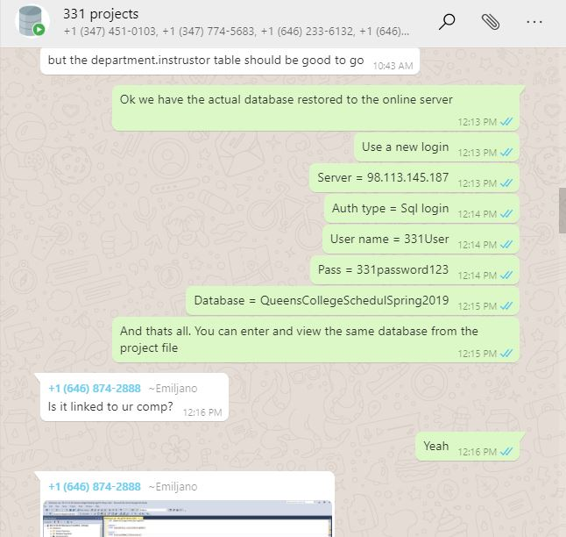
Learning to set up an online database

Slide 4
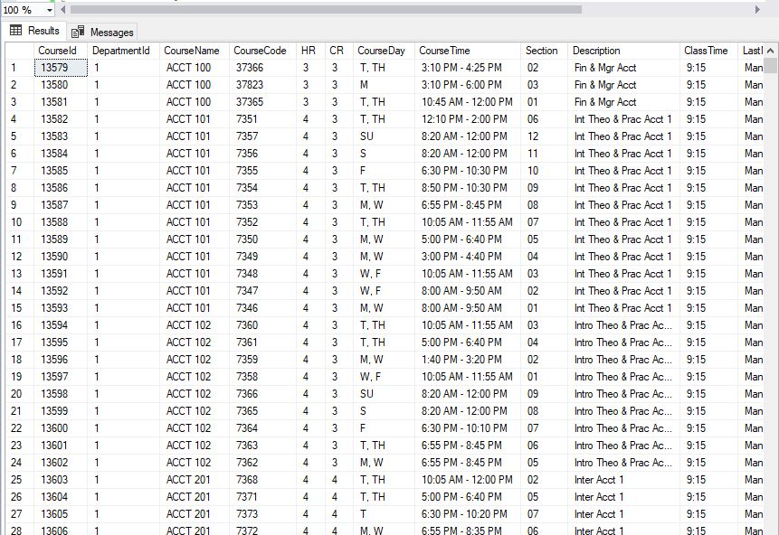
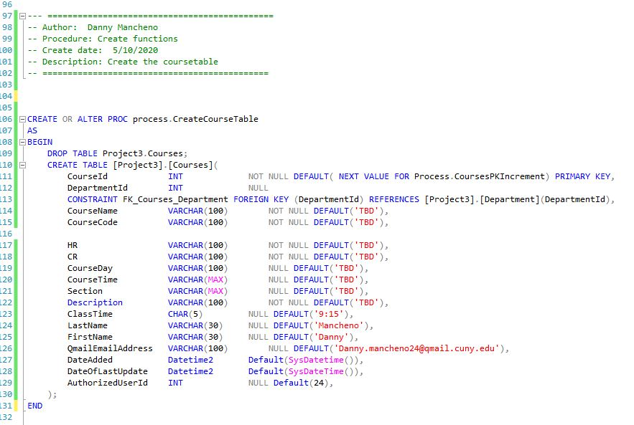
Working on the course table

Slide 5
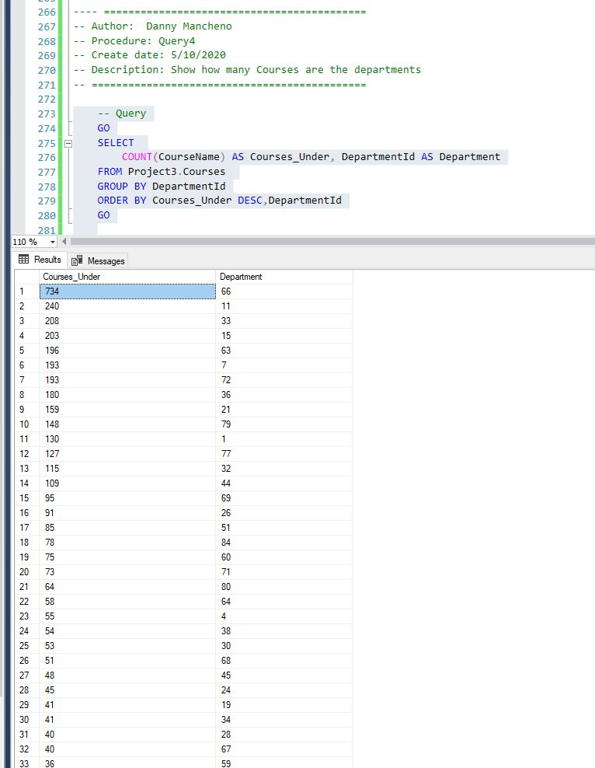
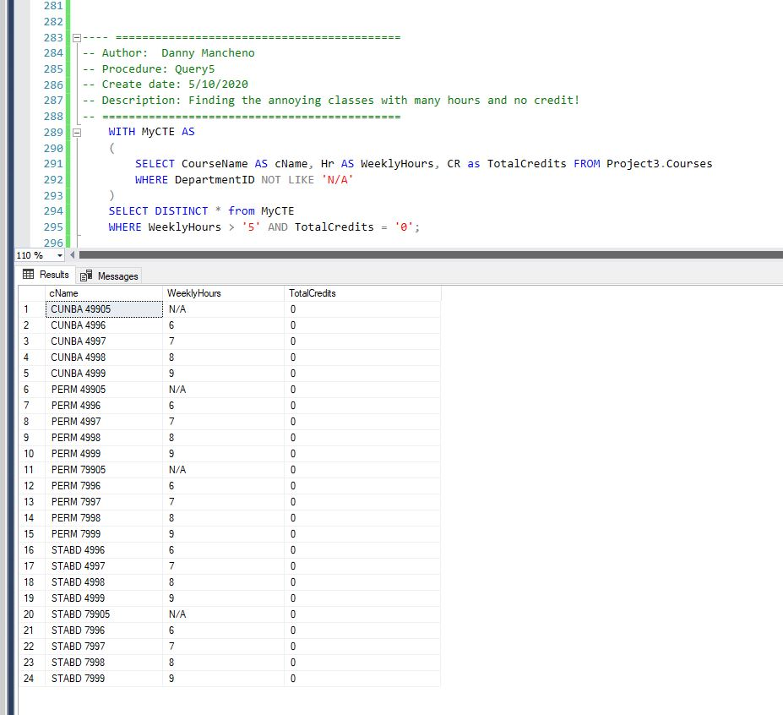
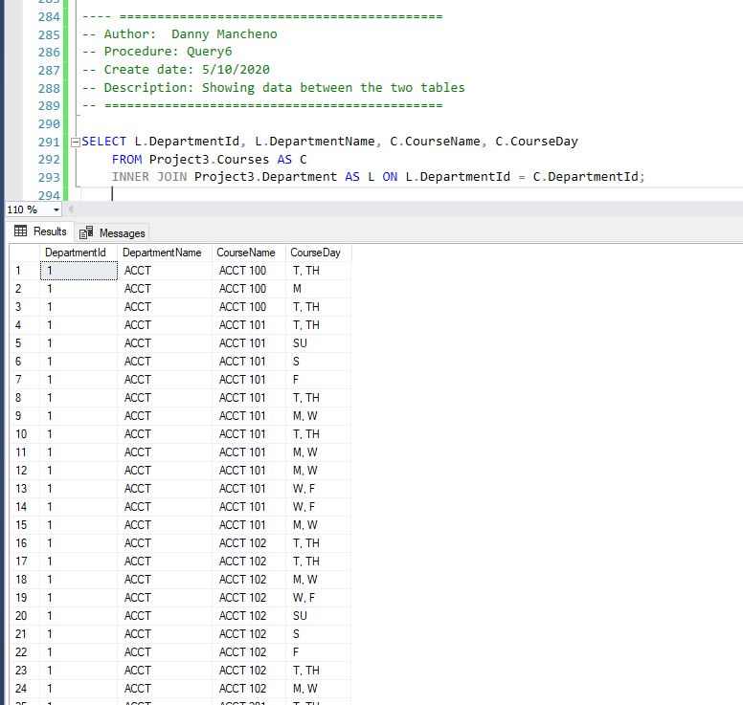
Running some simple queries to test

Slide 6
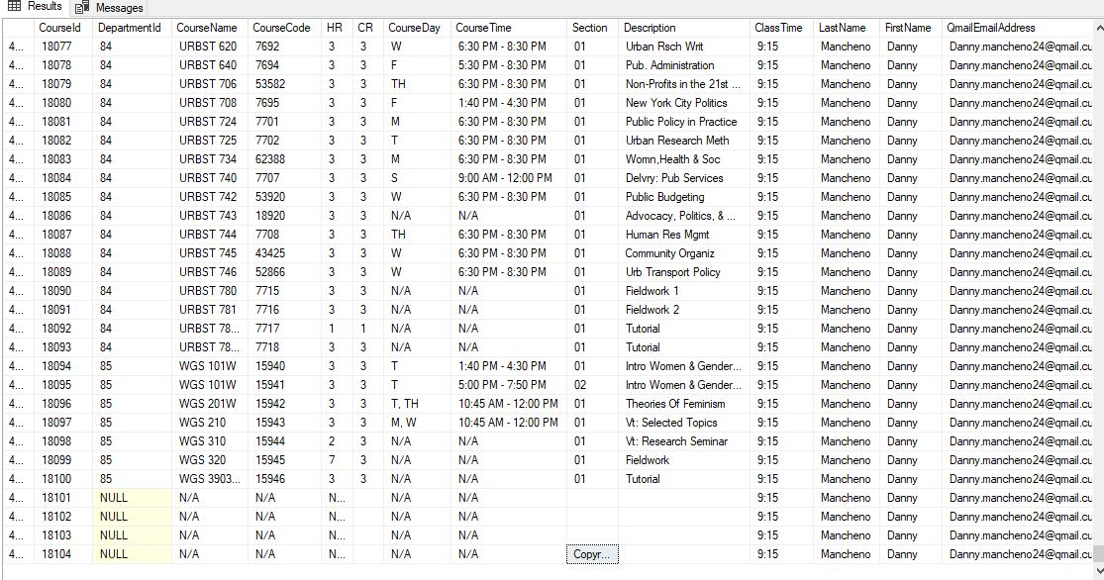
Data Anomalies.

Slide 7
Conclusion
- Learned how to get the database online for the group
- Worked on my table, attempted another.
- Helped the group around to debug and deal with foreign key constraints.
- It can’t be overstated how pesky foreign keys can be when you try to alter data around between tables.
- But I understand their use, and importance to separate data.

